Slide 1

TEHPOSTACH, Private Enterprise
Registered in 2000
Corporate ID: 31091784
Office location: Lviv, Ukraine
Tehpostach PE is a main company of TEHPOSTACH group of Ukrainian companies, specializing in manufacturing ladies, men's and work clothing as well as other allied textile items.
Three production units in Ukraine
38 permanent employees
EU export oriented, experience of cooperation with many brands
www.tehpostach.com

Slide 2

Manufacturing Outsourcing
Key features of working with us:
Many years of clothes manufacting experience;
Expert in the area of workwear, lifejackets and casual clothes;
Highly qualified management and a team of specialists;
Following the highest quality standarts;
Products we manufacture
Workwear
Jackets
Lifejackets
Uniforms
Hoodies & Sweatshirts
Pants & Trousers
Children's Clothing
Coats
Shorts
Vests & Waistcoats

Slide 3
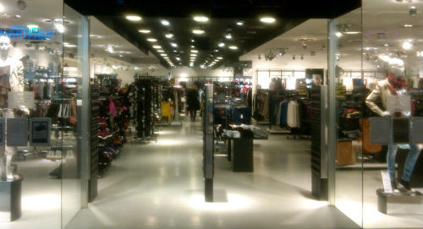
BRANDS AND CUSTOMERS
We’re experienced in manufacturing clothes for European brands. Due to the non-disclosure agreement (NDA) which have been signed with some customers, only a part of our key customers list is published here.
Baltic Safety Products (Sweden)
FHB (Germany)
Hertel (Belgium)
Carole Richard (France)
Gigue (Belgium)
Hugo Josten (Germany)
Kappahl (Sweden)
Sarco (Belgium)
Mayerline (Belgium)
Mexx (The Netherlands)
Fristads Kansas (Sweden)
Natural (Belgium)
New Look (Great Britain)
and other brands

Slide 4
CONTACT US
Headquarters and postal address:
Tehpostach PE
20, str. Himichna
L’viv 79058
Ukraine
Call us:
+380 322324077
+380 322324074
+380 672202534
Contact us by e-mail:
roman@tehpostach.com

